Slide 1


Career Paths for Students with a Degree in Nutrition
Presented by Dr. Susan Massad
Monday, March 28 1:30-2:20
Hemenway Hall 312

Slide 2
Good news from the
US Bureau of Labor Statistics:
Employment of dietitians and nutritionists is projected to grow 21% from 2012 to 2022, faster than the average for all occupations.
Fitness and aerobics instructors: projected = increase 13%
Role of food and exercise in preventing & treating illnesses, such as diabetes: now well known.
More Dietitians & Nutritionists needed to care for patients with various medical conditions and to advise people who want to improve their overall health.
Nutrition: http://www.bls.gov/oes/current/oes291031.htm
Fitness: http://www.bls.gov/oes/current/oes399031.htm

Slide 3



Careers listed in
Academy of Nutrition & Dietetics site:
http://www.eatrightpro.org/resources/career/career-development/eatright-careers
Job search: http://www.healthecareers.com/eatright?type=url&source=eatright-lndgpg-jbsrch-js

Slide 4
Other job sites:
Jobrapido:
  http://us.jobrapido.com/?w=nutrition&l=usa&r=auto
Nutrition Jobs:
  http://www.nutritionjobs.com/
Indeed:
  http://www.indeed.com/jobs?q=Nutrition&l=USA
Career Builder:
  http://www.careerbuilder.com/?sc_cmp2=js_home_cblogo
Monster:
  http://www.monster.com/

Slide 5

Employment Trends 2016
Alarming increase in obesity has turned public attention to nutrition more than ever
Healthcare (hospitals, assisted living)
Food industry, Super Market Dietitians!
Dietitians/Nutritionists may analyze
foods, prepare literature on current
nutritional issues, write articles for general public
More jobs involve computer technology (e.g. diet analysis software, “apps”)
https://www.acsm.org/about-acsm/media-room/news-releases/2014/10/24/survey-predicts-top-20-fitness-trends-for-2015

Slide 6
Some "outside of the box" jobs held by nutrition graduates:
Chiropractic office, running front desk, developing X-rays, doing exercise and nutrition consultations with patients. Also training as a chiropractic technician (which involves more clinical work)
Correctional facility (prison): food service, some clinical
Communications/corporate reputation consulting. (Background in nutrition and nutrition policy was what set the foundation for this type of job).
Working for the FDA regulating imports.

Slide 7
Interesting business
RD opportunity:
“On Demand Dietitian”
http://ondemanddietitian.com/opportunities/ “Seeking RDs with a progressive, holistic approach who stand on the forefront of the latest in nutrition.
On Demand Dietitian is reinventing the traditional nutrition counseling structure for benefit of both patient and RD. Mobile RD position allows RDs to work from home and create their own schedules. RDs are able to promote themselves based on their nutritional expertise and area of specialty. Mobile RDs become known within our nationwide network and build their own clientele due to their expertise!”

Slide 8
What are our recent graduates doing?
Sodexho here on campus
Wellness Coordinator
Quality Assurance Technician for supermarket chain
Health Educator, Yale University Wellness Center
Quality Ingredient Manager for “Kashi” Foods
Professional Research Assistant for NIH study
Public School Food Service Director
Prepared Foods Supervisor for Whole Foods
Nutrition Team Specialist at the Trader Joe's
Sales Rep for a pediatric medical nutrition company
Nutrition Program Manager for grant funded program: Healthy Schools, Healthy Families
Community Nutritionist – Head Start and WIC
Nutrition Consultant for USA Swim team
Sports Nutritionist at private health club Cont.→

Slide 9
Our recent graduates’ jobs, cont.
Clinical Dietitian for hospitals and nursing homes (many different specialties – renal, cardiac, pediatric, bariatric)
Sensory Analyst for “Daymon Worldwide” (designs, executes, and analyzes results from consumer tests and sensory evaluations of private label and competitive brand retail food products)
Vice President: Client Support & Education with The CBORD Group, Inc. (Food service company). https://www.cbord.com/news/pressrel.asp?id=302
Product tester:
  http://www.nutritionjobs.com/job/product-trainer-non-rd-rdn-massachusetts-framingham-ma-rewco-inc-_12198

Slide 10
Recent graduates jobs, cont.
Fort Myers Florida Sodexo: MAGIC, a business branch of Sodexo lead by Magic Johnson.
  Sports Dietitian for the Minnesota Twins Baseball Organization at their Minor League Academy.
  All injured players and those within the 7 minor leagues run through the facility throughout the year and the major league attends during spring training.
  The current Nutritionist regularly does individual counseling, and group education sessions which are videotaped and offered to all leagues.
  Nutritionist has full range over the menu and kitchen.

Slide 11
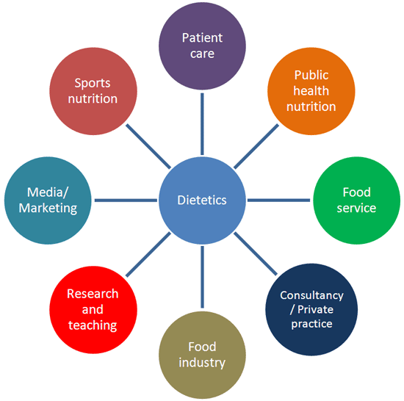
Career Paths
Food Service
Clinical
Community
Research
Sports
Health Education
Computers
Business
Sales
Private Practice

Slide 12

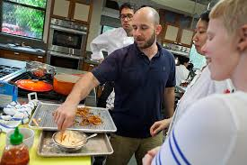
Food Service
Schools; See: http://www.schoolnutrition.info/
Business and Industry - management positions
Culinary Arts
Hospital/Restaurant Chains
  SODEXO Marriott
  Hannaford
  Aramark
  Morrisons
  Chartwells
  Unidine
  Health Care
  Hospitals
  Retirement
  Communities
FSU Alumnus, Bryan Roof, works for America’s test kitchen
http://www.kpbs.org/news/2014/mar/27/americas-test-kitchen-cooks-illustrated-classic-it/

Slide 13


Food Service
Experience is Essential
Develop Additional Skills
  Recall skills developed in Food Culture & Society and Exp. Study of Foods classes
  Food demonstration
  Presentation

Slide 14
Graduate Certificate in School Nutrition
Food Service
Now offered via our graduate and continuing education program:
  https://www.framingham.edu/academics/graduate-studies/graduate-certificate-programs/grad-certificate-school-nutrition-specialist/graduate-certificate-in-school-nutrition-specialist
Meets eligibility requirements to take SNA School Nutrition Specialist certification exam
Also see: https://schoolnutrition.org/sns/

Slide 15
Career as a School Nutrition Director or Assistant Director
With a BS in Food & Nutrition
From FSU you will have…
Foodservice Systems practicum experience
“ServeSafe” Certification
While you’re a student you can take advantage of opportunities to work with JSI to increase your school nutrition experiences.
More information, contact
Karen McGrail, Director of JSI
@ kmcgrail@framingham.edu
FSU offers a MEd in Nutrition Education with a concentration as a School Nutrition Specialist (SNS)
  10 online courses and 2 semester internship in a school nutrition program
  Qualifies you to take the SNS credentialing exam
For more information contact
Dr. Ann Johnson @ ajohnson3@framingham.edu

Slide 16


John C. Stalker Institute of Food and Nutrition (JSI) is a partnership between Framingham State University & Massachusetts Department of Elementary and Secondary Education.
JSI is located on the campus of Framingham State in the
Towers Office Suites and is center within the Food and Nutrition department.
Mission of JSI
Use current research and technology to educate and inform Massachusetts school professionals concerned with child nutrition and healthy nutrition environments.
JSI presents workshops, conferences and courses to professionals working in Massachusetts schools with the primary focus on school nutrition. JSI offers Massachusetts schools online resources to help promote a healthy school environment.
Check out our web site!
www.johnstalkerinstitute.org

Slide 17
School Nutrition Opportunities for JSI for Students
There are a variety of ways for FSU students to get involved. At JSI we have…
  2 Student Workers
  CHOICE program Internships – Go to RAMTrack for details
  Undergraduate Internships – NUTR 496 Internship in Food and Nutrition
  Graduate Internships
  School Nutrition Projects
The work we do at JSI may inspire you towards a career as a school nutrition director!
Follow us on Facebook
Connect on LinkedIn
www.johnstalkerinstitute.org

Slide 18
Government jobs:
Food service
Some positions require RD credential (e.g. Dietitian in a VA hospital), but many others do not.
All Federal jobs are listed on www.USAjobs.gov → can be searched by keyword (e.g. nutrition) by location and by pay) scale. Someone with a BS but not RD would probably look for positions in a GS-6 to GS-7 range.

Slide 19
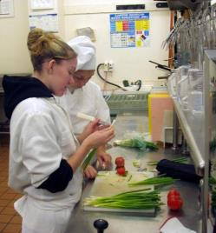
Food Service
Certifications
Food Safety and Sanitation Certification
through the Educational Foundation of the
National Restaurant Association
Also known as ServSafe
https://www.servsafe.com/ss/sra/ma/
(Now part of NUTR 384)

Slide 20


Schools
Food Service
School Nutrition Association of Massachusetts
  http://www.schoolnutrition.info/
Nutrition education training program
  http://www.doe.mass.edu/cnp/edtrain.html

Slide 21



Clinical
Clinical Dietitian jobs are typically in hospitals, assisted living facilities & nursing homes
Sample job description:
http://dot-job-descriptions.careerplanner.com/DIETITIAN-CLINICAL.cfm

Slide 22

Clinical
Other jobs:
Diet Technician in Hospital
  Responsibilities vary according to institution
  NOTE: you qualify to take the exam with a 4-year degree in Foods and Nutrition Dietetics:
  http://www.eatright.org/students/education/becomeregistered.aspx
  Diabetes Educator
    Certification www.ncbde.org
    RN, PA, RD, or MS in health field required
Research Assistants in Clinical Trials

Slide 23

Community
Employment
Opportunities
WIC 1-800-WIC-1007
http://www.mass.gov/eohhs/consumer/basic-needs/food/wic/
  Offices in:
  Boston Area
  Cape Cod
  Central Mass.
  Northeastern Mass.
  Southeast Mass.
  Western Mass.

Slide 24


Employment Opportunities, cont.
Community
Elderly Nutrition Program
  http://www.mass.gov/elders/meals-nutrition/mass-elderly-nutrition-program-sites.html
Food Banks:
  Worcester www.foodbank.org
  Western Mass. www.foodbankwma.org
  Greater Boston www.gbfb.org

Slide 25

Community
Helpful to have
Additional Training
Example: Become a “Freedom from Smoking Facilitator” through American Lung Association
  http://www.lung.org/stop-smoking/join-freedom-from-smoking/become-a-facilitator.html
  Local: http://www.lung.org/about-us/local-associations/massachusetts.html
  Springfield:
  http://www.lung.org/local-content/_content-items/our-initiatives/education-and-training/MA-ffs-springfield.html

Slide 26

“Extension Services”
Community
U Mass Extension Nutrition Education Programhttp://extension.umass.edu/nutrition/
Expanded Food and Nutrition Education Program (EFNEP)
  http://extension.umass.edu/nutrition/expanded-food-and-nutrition-education-program-efnep
2. Supplemental Nutrition Assistance Program Education (SNAP-Ed)
http://extension.umass.edu/nutrition/supplemental-nutrition-assistance-program-education-snap-ed

Slide 27



Media
Nutrition writer for health newsletter, magazine, or other media
Nutrition writer for Internet, including nutrition articles, “ask a nutritionist”, message board moderator
Contributor or employee for nutrition or health-related internet company
Health speaker
Author - books, cookbooks
Food critic

Slide 28
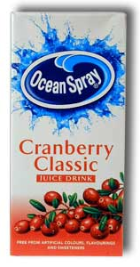
Research
Places for Employment
Food Industry -
  e.g. Ocean Spray http://www.oceanspray.coop/Careers.aspx
  Ocean Spray Consumer Affairs Department
  Ocean Spray Cranberries, Inc.
  One Ocean Spray Drive
  Lakeville-Middleboro, MA 02349
1-800-662-3263

Slide 29
Research
Federal Government US Army, Soldier Systems (Natick Lab)
    http://www.army.mil/info/organization/natick/
    US Army Soldier Systems Center
    Kansas Street
    Natick, MA 01760
    (508) 233-4300
Also U.S. Army Research Institute of Environmental Medicine
http://www.usariem.army.mil/
  Building 42, Kansas Street Natick, MA 01760-5007

Slide 30
Research, cont.
Clinical Trials
  PAREXEL Headquarters: 200 West Street Waltham, MA 02451-1163 USA Tel: +1 781 487 9900
  http://www.parexel.com/
  Center Watch http://www.centerwatch.com/clinical-trials/listings/condition/242/diet-and-nutrition
  HSPH Nurses Study – Harvard http://www.channing.harvard.edu/nhs/
  USDA Human Nutrition Laboratory on Aging http://hnrca.tufts.edu/

Slide 31
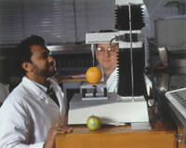
Food Research
Additional Training
Food Science Courses
Food Analysis
Food Chemistry
Food Microbiology
Food Engineering and Processing
Minor in Food Science
Take communications courses

Slide 32

Sports
If you have any prior certifications
(e.g. Personal Trainer, Lifeguard,
First Aid, CPR, etc.) → keep these
up-to-date and documented
May work with variety of audiences - children,
adults, elderly
Increased interest in diet analysis/software skills
Note: recent job posting for Nutritionist at
area YMCAs
  http://www.ymca.net/career-opportunities/open-positions.html

Slide 33
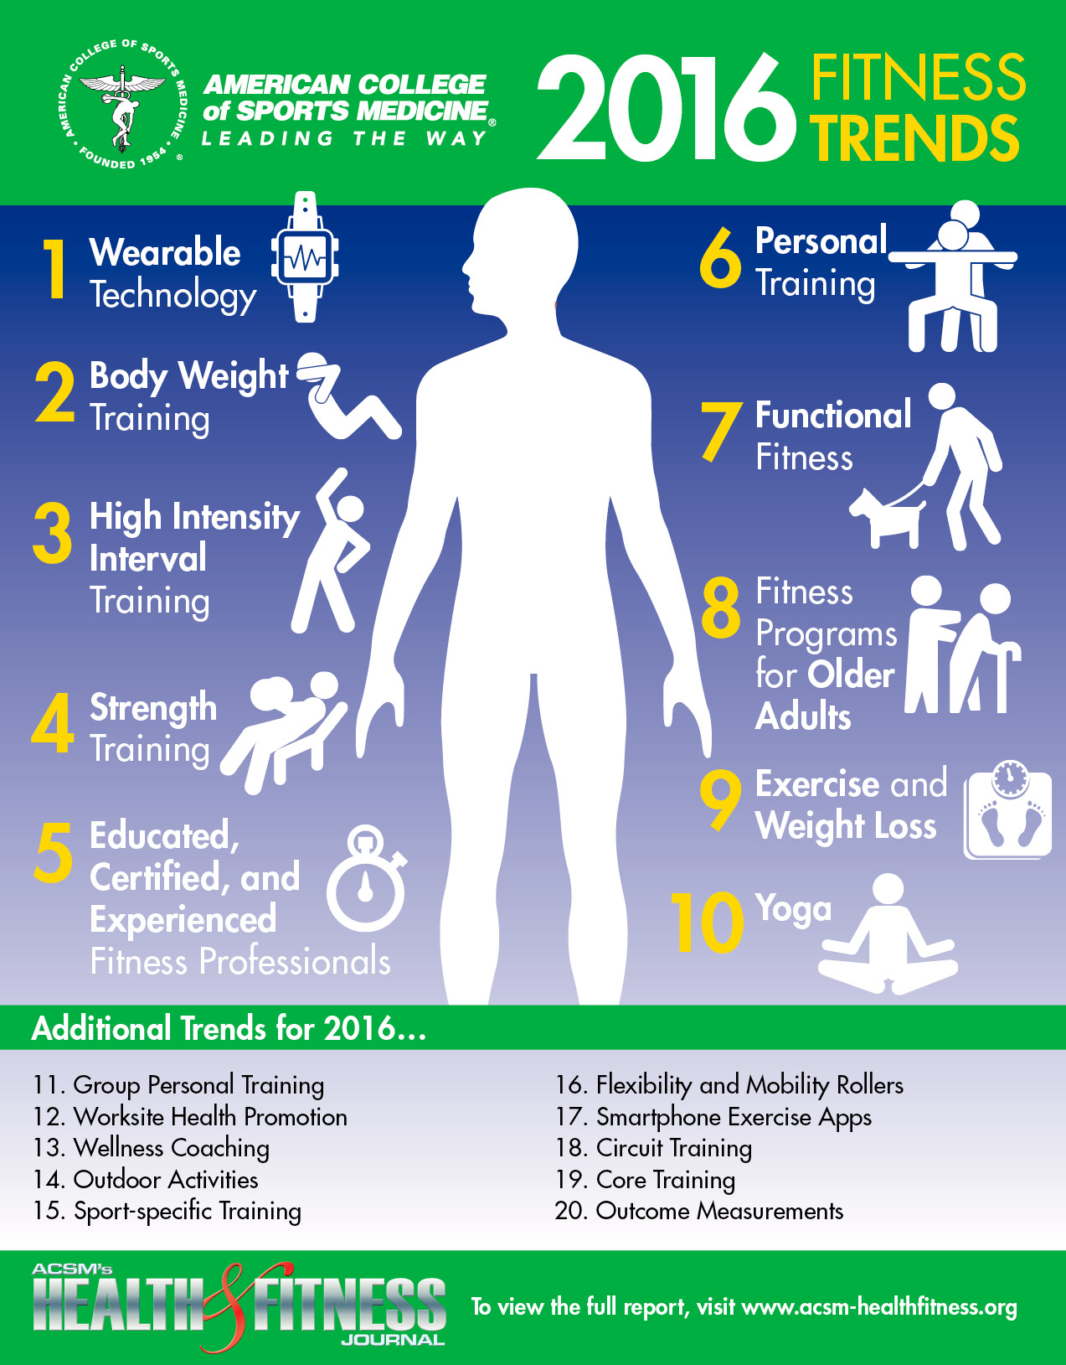

Slide 34


Sports
Certifications
ACE (American Council on Exercise) Certifications:
  Group Fitness Instructor
  Health coach
  Personal Trainer
  Fitness Nutrition Specialty Certification
  800-234-9229 www.acefitness.org
ACSM American College of Sports Medicine
317-637-9200 www.acsm.org

Slide 35


Sports
Additional Training
First Aid
CPR
Water Safety
Yoga

Slide 36

Sports
http://www.americankinesiology.org/careers-in-kinesiology/careers-in-kinesiology/careers-in-kinesiology

Slide 37
Sports
Might include graduate school and/or additional training
Adapted PE
Athletics administrator
Coaching
Research
Strength and conditioning
Nursing
Occupational therapy
Physical education
Physical therapy
Sports journalist
Fitness and wellness blog
Sports marketing
Sports management
  Minor available at FSU!
http://www.americankinesiology.org/featured-careers/featured-careers/exercise-physiology

Slide 38
Health Education
Places for Employment
HMOs
Family Planning
American Cancer Society
Red Cross
March of Dimes
Lung Association (Get Facilitator Training for American Lung Association's adult smoking cessation program)
American Heart Association
Schools – Teaching
Worksites – Corporate Wellness Program

Slide 39
Health Education
Certifications Available
Massachusetts Teacher Certification in
Health/Family and Consumer Sciences
Graduate programs at:
Bridgewater State College
Springfield College
Worcester State College
Certified Health Education Specialist CHES
National Commission for Health Education Credentialing Inc. http://www.nchec.org/

Slide 40
“Health and Wellness Coach”
New credential:
  http://ncchwc.org
Have seen recent listings for health and wellness coordinators at the YMCAs
Some training offered through the Mayo Clinic:
  http://www.mayo.edu/research/centers-programs/nicotine-dependence-center/education-program/wellness-coaching-program/wellness-coaching-program

Slide 41
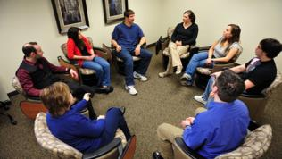

If you’re interested in:
Psychology and weight management
Stress management
Disordered eating
Eating disorders
Combine your nutrition
knowledge with a
Master’s degree in counseling

Slide 42
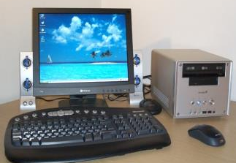
Computers
Develop your skills
  diet analysis
  presentation software
  spreadsheets
  data control
  statistics
  Internet research
  writing – technical
  design - graphic
Minor in
Computer Sciences
NOTE: Computer Applications in Nutrition course will help you sell yourself

Slide 43
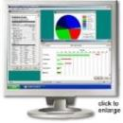
Computers
Nutrition Software Companies
Computrition -Bedford, MA & Chatsworth, CA
  http://www.computrition.com/career-opportunities/
The Nutrition Company:
  http://www.nutritionco.com/
Nutritionist Pro:
  http://axxya.com/diet_analysis_program.php
“Dine Healthy” in Wilmington NC
  http://www.dinehealthy.com/
C-Bord - Ithaca, NY:
  https://www.cbord.com/jobs/

Slide 44

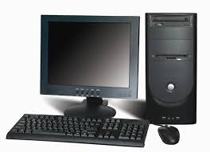
Business
Additional Training
Helpful to have a minor
  Business
  Instructional Technology (IT)
  Writing
  Computer science
  Marketing
  Communication

Slide 45


Business
Employment Opportunities
Computer Companies
Pharmaceutical Companies
Novartis
Ross Pharmaceuticals
Pfizer Pharmaceuticals
Food Companies

Slide 46
Pharmaceutical Sales
Business
Some pharmaceutical and/or blood
glucose meter companies seek personnel with nutrition expertise:
  Abbott http://www.abbottdiabetescare.com/
  Bayer http://www.abbottdiabetescare.com/
  Diabetic Supply of Suncoast http://www.dsosi.com/
  Diagnostic Devices http://www.diagnostic-devices.com/
  Hypoguard http://www.arkrayusa.com/
  HealthPia http://healthpia.us/
  Cont. →→

Slide 47
Pharmaceutical and/or blood glucose meter companies , cont.
Business
Lifescan http://www.lifescan.com/
U.S. Diagnostics http://www.usdiagnostics.net/
WaveSense http://www.usdiagnostics.net/
Also see: http://www.diabetesmonitor.com/glucose-meters/brands

Slide 48
Local Pharmaceutical Company:
Business
Nova Biomedical http://www.novabiomedical.com/careers/
Nova Biomedical
  Attn: Human Resources
  200 Prospect Street
  Waltham, MA 02454-9141
  Fax: 781-899-6259
* Sell glucose monitors and other diagnostic equipment

Slide 49


Food Companies:
E.g. Whole Foods
& Trader Joes
Whole Foods
  http://www.wholefoodsmarket.com/careers
Example of recent listing: Prepared Foods Department Manager
Trader Joes
  http://www.traderjoes.com/careers
  Example of recent listing: Nutrition Team Specialist

Slide 50
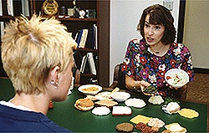
Private Practice
Coundeling skills required
Combine nutrition degree with other specialized training
State licensure will help – exam
Need to develop a business plan to focus yourself
Not recommended for you right out of college – need experience

Slide 51


Work towards a creative niche
Private Practice
Nutrition counseling with personal chef
Personal training with nutrition counseling
Nutrition counseling with complementary health practices
Family and nutrition counseling

Slide 52
Massachusetts Board of Registration of Dietitians and Nutritionists
http://www.mass.gov/ocabr/licensee/dpl-boards/nu/forms/
Requires 4-year degree in nutrition and 900 hours of work experience in the nutrition field

Slide 53
Another option for someone willing to travel
Be an interviewer for large national surveys such as NHANES.
“Westat” is the contractor for NHANES and many other surveys, and openings are listed on their Web site:
Ex: “Field data collectors”
  http://westatcareers.jobs/

Slide 54
Common Job Titles
Dietitian
Nutritionist
Food Service Manager
Child/School Nutrition Specialist
Nutrition Educator
Community Health Educator
Sales Representative
Research Scientist

Slide 55
Common Fitness Titles
Personal Trainer
Physical Education Teacher/Instructor
Head/assistant Coach
Strength and Conditioning Specialist
Activities Director
Fitness Club/Department Manager
Academic Counselor (NCAA)
Sales Representative

Slide 56
General Career Information for Dietitians and Nutritionists:
U.S. Department of Labor
Bureau of Labor Statistics
http://www.bls.gov/ooh/Healthcare/Dietitians-and-nutritionists.htm
Dietitian Central
http://www.dietitiancentral.com/index.cfm
Dietitians and Nutritionists
http://www.collegegrad.com/careers/proft76.shtml

Slide 57
Other general resources
Indeed job search
  http://www.indeed.com/q-Nutritionist-l-Massachusetts-jobs.html
WIC
  http://www.fns.usda.gov/wic/jobs.htm
Sodexho
  http://www.sodexousa.com/usen/careers/students/opportunities.asp
Linked In
  https://www.linkedin.com/

Slide 58
Develop Your Portfolio
Your portfolio contains anything that communicates
your skills, talents and expertise.
Research Papers
Nutrition Analysis Projects
Nutrition Care Plans
Previous Job Evaluations
Consumer Education Materials
Writing Samples
See handouts from
career center
Be sure your samples are your best work.

Slide 59
Graduate School?
Consider School Food Service here at FSU: MEd with a specialization as a School Nutrition Specialist: https://www.framingham.edu/academics/graduate-studies/graduate-certificate-programs/grad-certificate-school-nutrition-specialist/graduate-certificate-in-school-nutrition-specialist
Also, MBA or MS in “Food Marketing”
  St. John’s University: www.sju.edu/execfood

Slide 60
Graduate School?
Many institutional members of the American Kinesiology Association have graduate programs:
http://www.americankinesiology.org/aka-member-departments/aka-member-departments/member-departments
Kinesiology is a diverse field with many opportunities (e.g., physiology, psychology, sociology, biomechanics, etc…)

Slide 61


Identify your transferable skills
Go on informational interviews
Develop unique skills
Develop a reputation for excellence
Keep writing samples – different types
Show off your artistic skills (if you have them)
Be a team player
Show your willingness to jump in and work

